Slide 1
Test Automation
Foundations of Test Automation
Notes:
Notes to the Facilitator:
Welcome the participants and give them an overview of the module. Tell them that they will learn about the ‘Foundations of Test Automation’ in this module.
Notes to the Participants:
You will learn about the ‘Foundations of Test Automation’ in this module.

Slide 2

Module Objectives
At the end of this module, you will be able to:
Understand the concept of test automation.
Comprehend different testing types and where automation is applied.
Recognize the benefits of test automation.
Differentiate between automated and manual testing.
Analyze scenarios suitable and not suitable for automation.
Evaluate criteria for selecting test automation tools.
Apply best practices and understand commonly used automation tools.
Notes:
Notes to the Facilitator:
Explain the module objectives to the participants.
Notes to the Participants:
You will be informed about the module objectives.
At the end of this module, you will be able to:
Understand the concept of test automation.
Comprehend different testing types and where automation is applied.
Recognize the benefits of test automation.
Differentiate between automated and manual testing.
Analyze scenarios suitable and not suitable for automation.
Evaluate criteria for selecting test automation tools.
Apply best practices and understand commonly used automation tools.

Slide 3
Module Topics
Let us take a quick look at the topics that we will cover in this module:
Introduction to automation testing
Types - Unit Testing, Integration Testing, System Testing, Acceptance Testing
Why go for automated testing
Difference between automation over Manual Testing
Scenarios suitable for test automation
Scenarios not suitable for test automation
Criteria for test automation tool selection
Best practices of automated testing
Benefits and limitations of automated testing
Test automation process
Overview of Popular Tools (Selenium, Appium, TestNG)
Notes:
Notes to the Facilitator:
Inform the participants about the topics that they will be learning in this module.
Notes to the Participants:
You will learn about the following topics in this module:
Introduction to automation testing
Types - Unit Testing, Integration Testing, System Testing, Acceptance Testing
Why go for automated testing
Difference between automation over Manual Testing
Scenarios suitable for test automation
Scenarios not suitable for test automation
Criteria for test automation tool selection
Best practices of automated testing
Benefits and limitations of automated testing
Test automation process
Overview of Popular Tools (Selenium, Appium, TestNG)

Slide 4
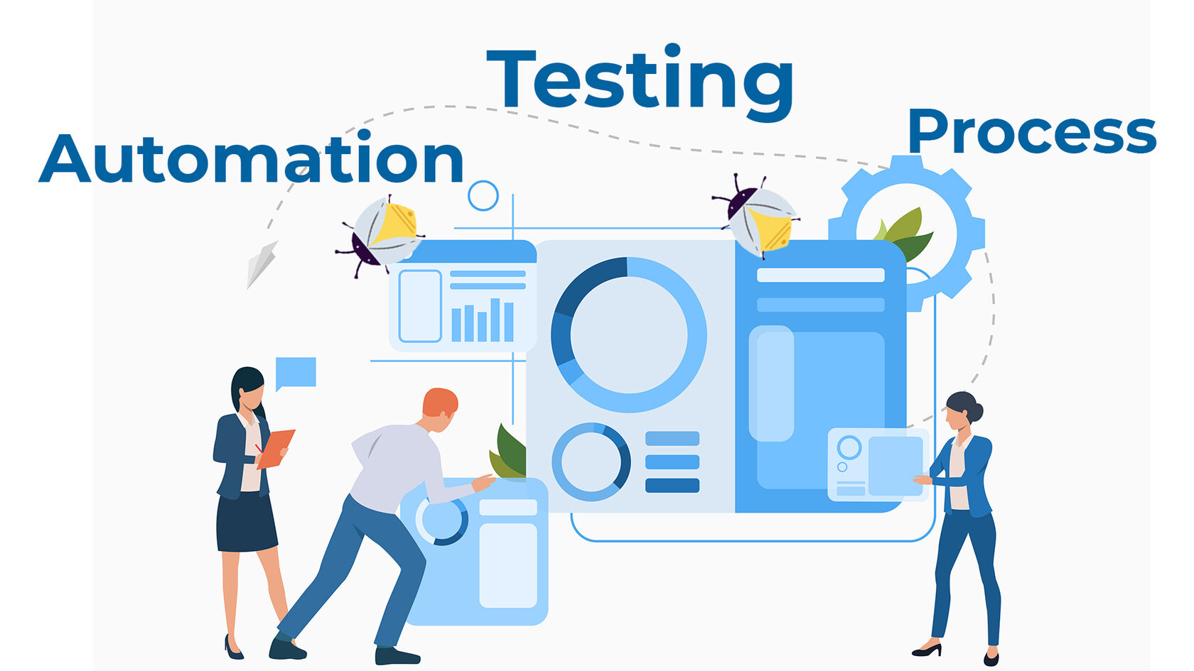
1.1.1 Test Automation: An Overview
Test automation is the use of tools to maintain test data, execute tests, and analyze results for enhanced software quality.
Improved testing efficiency.
Faster testing processes.
Higher return on investment (ROI) in automation implementation.
Benefits:
Notes:
Notes to the Facilitator:
Introduce participants to test automation as a method to enhance software quality by automating repetitive tasks, such as regression testing. Emphasize the benefits of increased efficiency, speed, and ROI compared to manual testing.
Notes to the Participants:
Let's start with the definition: “Test automation is the process of using automation tools to maintain test data, execute tests, and analyze test results to improve software quality.”
Test automation, also known as automated testing or automated QA testing, is a technique that is used to automate the process of validating software or the functionality of software to ensure that it conforms to the requirements. Once tested, the software or feature is ready to be released into the production environment.
We are already familiar with manual testing. Most of the tests that are done manually can be automated. Automation tools can replicate the steps of manual testing using an automation script. Consider, for example, regression testing. It is a wasteful practice for a user to keep doing the same thing over and over again. Moreover, a successive development cycle would require the running of the same test suite repeatedly. Hence, a better approach would be to record the tests and execute or re-execute them as required without human intervention. This is going to increase the effectiveness, speed of testing, and ROI (return on investment) of test automation implementation.
We are already familiar with manual testing. Most of the tests that are done manually can be automated. Automation tools can replicate the steps of manual testing using an automation script. Consider, for example, regression testing. It is a wasteful practice for a user to keep doing the same thing over and over again. Moreover, a successive development cycle would require the running of the same test suite repeatedly. Hence, a better approach would be to record the tests and execute or re-execute them as required without human intervention. This is going to increase the effectiveness, speed of testing, and ROI (return on investment) of test automation implementation.

Slide 5
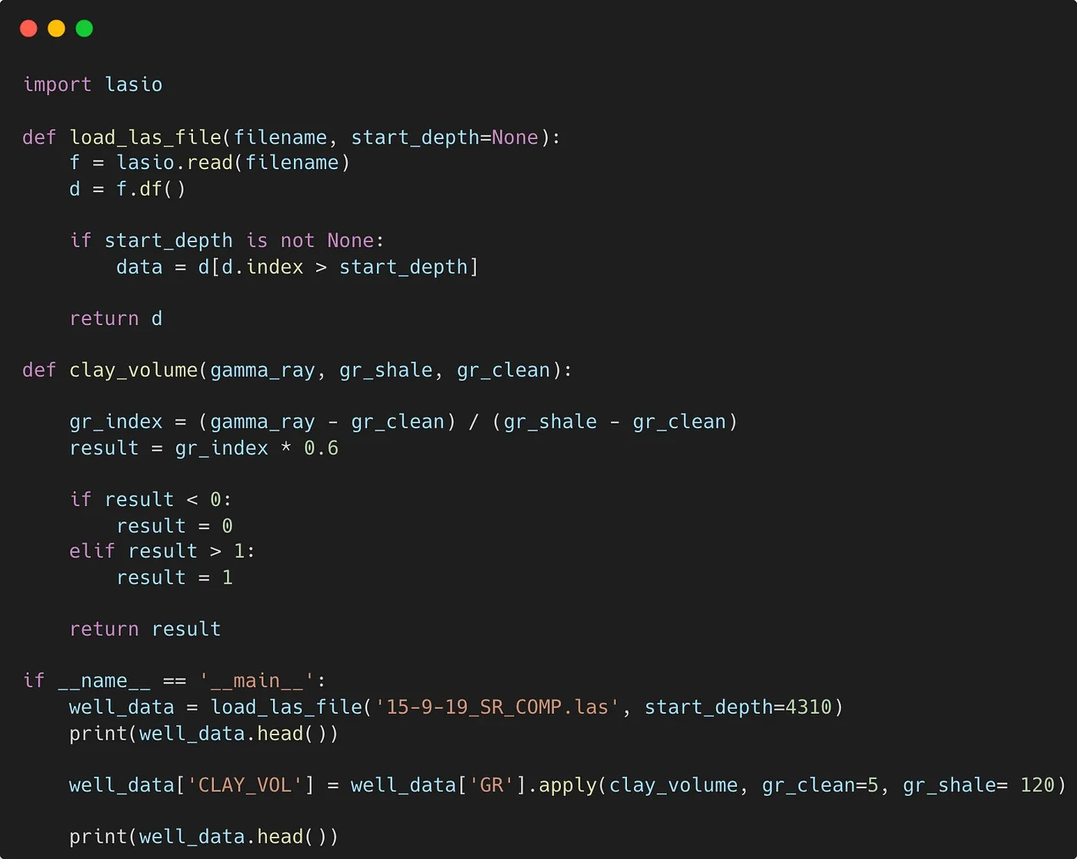
1.1.2 Automation Example : Python
import pytest
from selenium import webdriver
@pytest.fixture
def browser():
driver = webdriver.Chrome()
yield driver
driver.quit()
def test_page_title(browser):
browser.get("https://mywebsite.com")
assert browser.title == "mywebsite"
def test_form_submission(browser):
browser.get("https://mywebsite.com/form")
name_input = browser.find_element_by_name("name")
email_input = browser.find_element_by_name("email")
submit_button = browser.find_element_by_css_selector("input[type='submit']")
name_input.send_keys("Abc Xyz")
email_input.send_keys("abc.xyz@mywebsite.com")
submit_button.click()
success_message = browser.find_element_by_css_selector(".success-message")
assert success_message.text == "Form submitted successfully"
Notes:
Notes to the Facilitator:
Explain the program in terms of functionality as per the comment given to the program.
Notes to the Participants:
This is an example of automation testing using Python as programming language, pytest as testing framework and Selenium as the web automation library. This program tests the basic web application called mywebsite.com
As we can see, there are two test cases - test_page_title and test_form_submission where the browser fixture sets up and tears down a Selenium WebDriver instance for Chrome.
The test cases use this fixture to interact with a sample web application and make assertions about its behavior.

Slide 6

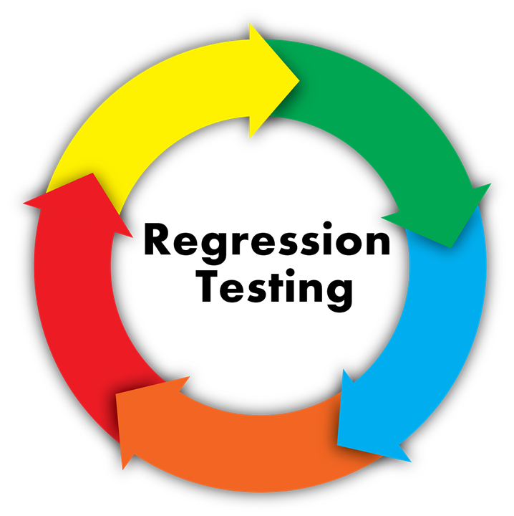
1.2.1 Why Automation Test?
Here are the reasons for adopting automation test:
Speed and Efficiency:
Automated tests can run much faster than manual tests
Faster feedback on the software quality
Run the tests as many times as needed
No additional costs
Regression Testing:
New feature or defect fixes part of cycle
Break existing functionality
Critical to identifying regressions
Ensure new changes don't break the existing functionality
Notes:
Notes to the Facilitator:
Explore the critical reasons for test automation, emphasizing its ability to enhance speed and efficiency, with a special focus on swift regression identification during feature additions or code changes.
Notes to the Participants:
In addition to streamlining and enhancing the software testing process, there are several reasons for implementing test automation. Let's see some of the critical reasons:
Speed and Efficiency:
Automated tests can run much faster than manual tests, thereby enabling a faster turnaround on software-quality feedback.
At the same time, we can run the automated tests as many times as needed without incurring additional costs. This makes it the perfect choice for carrying out repeated testing, such as regression testing.
Regression Testing:
When adding a new feature to the software or making code changes to fix a known bug or defect, there are chances that the code changes may break the existing functionality. Hence, automated tests become critical for quickly identifying regressions to make sure that the new changes don't break the existing functionality.

Slide 7
1.2.2 Why Automation Test?
Here is another reason for adopting automation test:
Cost and Time Savings:
Automating repetitive tasks saves time and money.
Catch the majority of defects before the the software goes into production.
Initial investment, but the long-term benefits
38%
21%
21%
9%
6%
5%
Negative
(making a loss)
None (no cost/
time savings)
Low (<20%
cost or time
savings)
Average (20%
of cost or
time savings)
High (20%-50%
of cost or
time savings)
Average (50%+
of cost or
time savings)
ROI of test automation.
Notes:
Notes to the Facilitator:
Stress the time- and cost-saving benefits of automated testing, noting its efficiency in early defect detection and long-term savings despite the initial script creation investment.
Notes to the Participants:
Cost and Time Savings:
As it is said, “Time is money, and automation saves both by automating repetitive tests and finding bugs early."
Automated testing enables us to catch the majority of defects before the software goes into production and reduces the time and effort required for manual testing. There is, of course, an initial investment in creating automated test scripts, but the long-term benefits include major savings in terms of time and cost.

Slide 8


1.2.3 Why Automation Test?
Here are more reasons for adopting automation tests:
Reusability:
Scripts are reused across different phases of the software development life cycle.
Allows the user to focus on other critical and complex tasks.
Test Coverage:
Manual testing: chances of missing edge cases or a negative scenario
Automated tests cover a wide range, including edge cases and negative test cases.
Notes:
Notes to the Facilitator:
Emphasize the efficiency of reusing automated test scripts across various software development phases and underscore the comprehensive test coverage they offer, minimizing the risk of overlooking critical scenarios present in manual testing.
Notes to the Participants:
Reusability:
Automated test scripts, once developed, can be reused across different phases of the software development life cycle.
A test automation script written for functional testing can be reused again for regression testing.
This allows the user to focus on other critical and complex tasks.
Test Coverage:
During manual testing, there are often chances that a tester may miss edge cases or negative scenarios.
But automated tests can cover a wide range of scenarios, including edge cases and negative test cases.

Slide 9

1.2.4 Why Automation Test?
Here are more reasons for adopting automation tests:
Accuracy and Consistency:
Automation reduces the possibility of human error during test execution.
Provides consistent, accurate, and repeatable results.
Reduces false positives or false negatives in test results
Parallel Execution:
Automated test scripts can be run in parallel on multiple infrastructures or devices.
Supports testing across different configurations
Reducing the overall test execution time
Notes:
Notes to the Facilitator:
Stress the benefits of automated testing, highlighting its role in ensuring accuracy, consistency, and efficiency through the elimination of human errors, reliable results, and parallel execution.
Notes to the Participants:
Accuracy and Consistency:
Since automation testing removes human intervention, it also reduces the possibility of human error during test execution, providing consistent, accurate, and repeatable results.
It also reduces the chances of false positives or false negatives in test results.
Parallel Execution:
Unlike manual testing, automated test scripts can be run in parallel on multiple infrastructures or devices, supporting testing across different configurations while also reducing the overall test execution time.

Slide 10
What did you grasp?
Q1. Can we do 100% automation?
Q2. Automated regression testing can save time.
Q3. Automated tests can run much faster than manual tests.
Notes:
Notes to the Facilitator:
Ask the participants to attempt the questions on the screen
Answer:
Q1. No
Q2. Yes
Q3. Yes
Notes to the Participants:
Attempt the questions on the screen. You will get one attempt.

Slide 11
1.3.0 Types of Automated Tests
Some important types of Automated Tests are:
Types of Automated Tests
Unit Testing
Integration Testing
System
Testing
Acceptance Testing
Notes:
Notes to the Facilitator:
Introduce different types of automation tests in brief to the participants.
Notes to the Participants:
We will cover some widely used automation tests that are important in the industry and can serve as a good starting point.
Unit Testing
Integration Testing
System Testing
Acceptance Testing
Let's discuss each of the above in the upcoming slides.

Slide 12
1.3.1 Testing Stages in SDLC
Here are the key testing stages in the software development lifecycle:
Deployment & Delivery
Requirements Gathering
Testing
Feasibility Analysis
Design & Development
Unit Testing
Integration Testing
Systems Testing
Acceptance Testing
Notes:
Notes to the Facilitator:
Explain the key testing stages in the software development lifecycle, spanning from unit testing to acceptance testing, ensuring software quality, and meeting project requirements.
Notes to the Participants:
The testing process in the Software Development Lifecycle is an important phase to ensure the software quality, reliability, and functionality of the software application being developed.
The testing process spans several stages, starting with unit testing. Below is a high-level overview of the process of testing in SDLC:
It starts with the requirements analysis and planning phase, where the main objective is to understand the project requirements and plan the testing strategy.
Unit testing, where the main objective is to validate the correctness of individual units, is where users write and execute unit tests for individual functions or methods.
Usually done by the programmers who write code
Followed by Integration Testing, where the main objective is to evaluate the interactions between integrated components. This is the place where we identify and address issues related to the integration of components.
Followed by System Testing, where the main objective is to evaluate the entire software system as a whole.
Usually performed by professional testing agents
Finally, there is Acceptance Testing, where the main objective is to validate whether the software satisfies the required acceptance criteria. All the stakeholders and end users often participate in carrying out the test in a simulated environment.
Usually performed by end users

Slide 13

1.3.2 Unit Testing
Unit testing is performed to validate the correctness of the individual components before all units are integrated.
Some of the major activities performed in the unit test are:
Write and execute unit tests for individual functions or methods.
Automate the execution of unit tests using automated testing frameworks.
Identify and fix defects at the code level.
Notes:
Notes to the Facilitator:
Highlight the key role of unit testing in the software development lifecycle, emphasizing its focus on testing individual components, validating behavior, and identifying defects through activities like writing and automating tests.
Notes to the Participants:
Unit testing is a fundamental practice in the software development lifecycle and is one of the essential components of a comprehensive test strategy. It is a technique where individual components of a software system are tested separately.
The word "unit" in unit testing refers to the smallest testable part of an application, which could be a single function or method. The main goal of unit testing is to validate and ensure that each unit of the software behaves as expected before it is integrated with other units.
Some of the major activities performed in the unit test are:
Write and execute unit tests for individual functions or methods.
Automate the execution of unit tests using automated testing frameworks.
Identify and fix defects at the code level.

Slide 14
1.3.3 Integration Testing
Integration testing is performed to validate the interactions between integrated components. It is also known as end-to-end testing.
Major activities performed are:
Combine units to test their interactions.
Identify and address problems related to the integration of various components.
Ensure the correctness of data flows between integrated modules.
Integration Testing
Module A
Module B
Notes:
Notes to the Facilitator:
Emphasize the key role of integration testing in SDLC, focusing on testing grouped components, identifying communication defects, and addressing integration-related issues, including testing interactions and ensuring correct data flows between modules.
Notes to the Participants:
During integration testing, individual software components or units are integrated and tested as a group, which is also known as end-to-end testing in SDLC. Software engineers develop many smaller modules or components that compose a software application. Each component could be developed by different engineers, and hence it is crucial to ensure that all components, when integrated, perform as expected per the design. Hence, the purpose of this testing is to expose defects in the communication between components.
Some of the major activities performed in the unit test are:
Combine units to test their interactions.
Identify and address problems related to the integration of various components.
Ensure the correctness of data flows between integrated modules.

Slide 15
1.3.4 System Testing
System testing is performed to validate the entire software system as a whole according to the specification.
Major activities performed are:
Validate the entire system against functional and non-functional specifications.
Perform testing to verify that the whole system performs as expected.
Identify and address issues related to system behavior and performance.
Notes:
Notes to the Facilitator:
Highlight the crucial role of system testing in validating the entire software system against specifications, ensuring expected performance, and addressing issues related to system behavior and performance, performed after integration testing and before acceptance testing.
Notes to the Participants:
System testing is a process of black-box testing that validates the functionality and performance of an integrated software application. It is performed after integration testing and before acceptance testing.
Some of the major activities performed in the unit test are:
Validate the entire system against functional and non-functional specifications.
Perform testing to verify that the whole system performs as expected.
Identify and address issues related to system behavior and performance.

Slide 16
1.3.5 Acceptance Testing
Acceptance testing is performed to validate that the software meets the specified acceptance criteria.
Major activities performed are:
Conduct testing in a simulated or real-world environment.
Engage stakeholders, such as end-users, in testing.
resolve any conflict between the final delivered product and user expectations.
Notes:
Notes to the Facilitator:
Highlight the significance of acceptance testing as the final phase, involving stakeholders to validate requirements, conduct testing in real-world conditions, and address conflicts between the delivered product and user expectations.
Notes to the Participants:
Acceptance testing is performed to validate if the requirements of a specification are met as per the agreement. It is often performed by the customer user or stockholders whoever is involved in this process.
Acceptance testing is performed in the final phase of testing after unit, integration, and system testing are completed.
Some of the major activities performed in the unit test are:
Conduct testing in a simulated or real-world environment.
Engage stakeholders, such as end-users, in testing.
resolve any conflict between the final delivered product and user expectations.

Slide 17
What did you grasp?
Which is the correct flow of testing in SDLC?
unit, system, integration, acceptance
system, unit, integration, acceptance
unit, integration, system, acceptance
integration, unit, system, acceptance
Notes:
Notes to the Facilitator:
Ask the participants to attempt the question on the screen.
Answer: C
Notes to the Participants:
Attempt the question on the screen. You will get one attempt.

Slide 18
What did you grasp?
When is System Testing performed in the software development lifecycle?
After Acceptance Testing
Before Unit Testing
After Integration Testing
Before Integration Testing
Notes:
Notes to the Facilitator:
Ask the participants to attempt the question on the screen.
Answer:
Q1. Unit testing
Q2. Integration testing
Q3. System testing
Notes to the Participants:
Attempt the question on the screen.

Slide 19
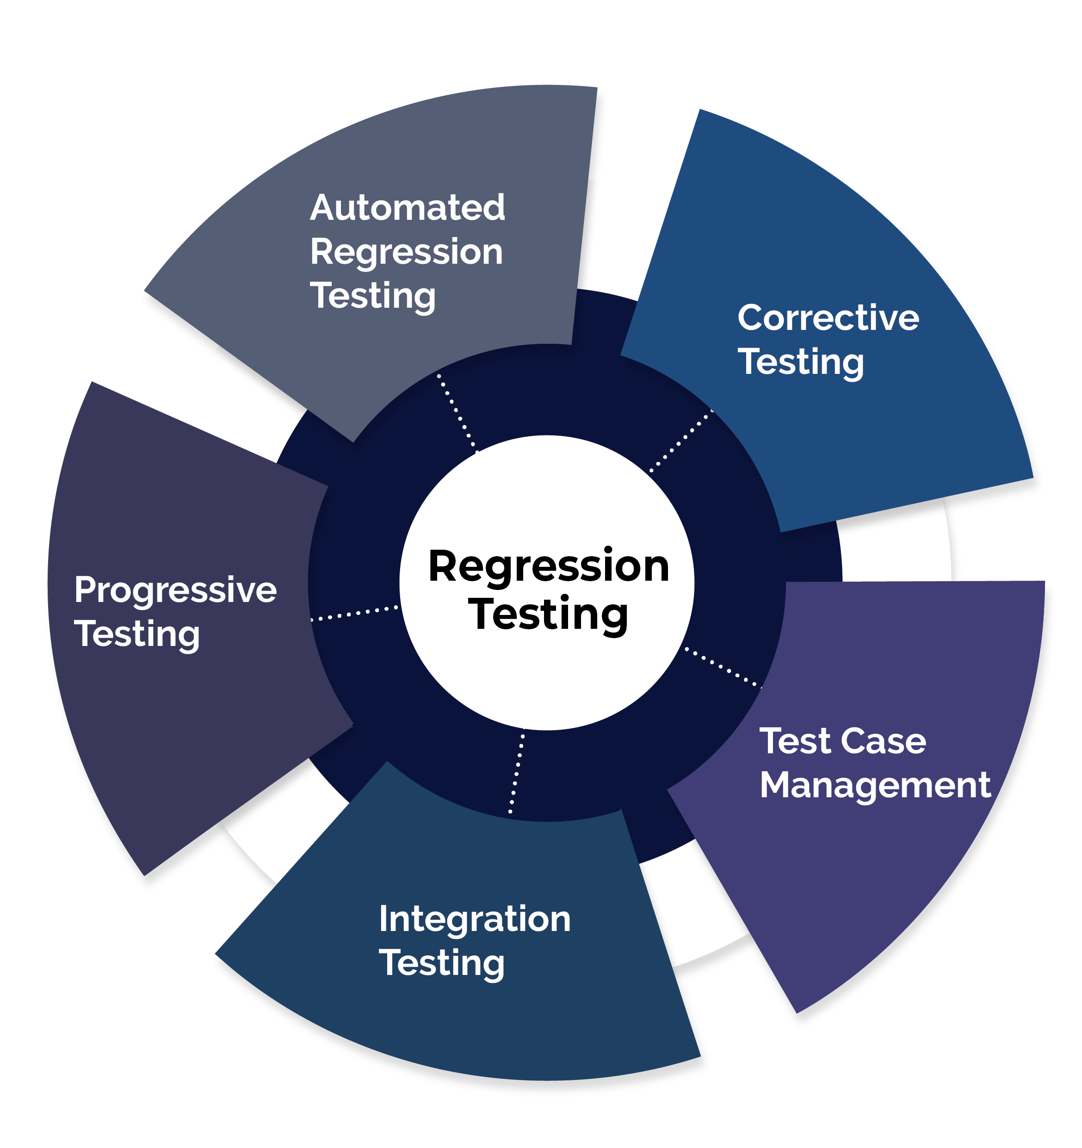
1.4.1 Automation Types: Regression
key features of Regression Testing Automation are:
Verify recent code changes
Prevent negative impacts on existing functionalities.
Cover new features, bug fixes, and enhancements.
Ensure system stability without breaking functionality.
Tools such as Selenium, JUnit, and TestNG are often used for regression testing.
Verify recent code
Prevent negative impacts
Tools such as Selenium
Cover new features
Ensure system stability
Notes:
Notes to the Facilitator:
Explain the concept of Regression Testing Automation to the participants.
Notes to the Participants:
In addition to automation of the previously discussed tests (unit, integration, system, and acceptance), automation can be categorized into various types based on the testing levels, objectives, and scope of automation. The choice of automation type depends on the testing objectives, application nature, and the requirements of the project. A well-balanced automation strategy requires a combination to offer comprehensive test coverage.
Let's list and discuss some of the common automation types.
Regression Testing Automation:
Regression test automation is a technique that aims to automate tests to verify recent code changes and ensure they do not negatively affect existing functionalities.
Such as new features, bug fixes, or enhancements.
The goal is to ensure that the overall system remains stable and doesn’t break existing functionality.
Tools such as Selenium, JUnit, and TestNG are often used for regression testing.

Slide 20
1.4.2 Automation Types: API Testing
Here are the points to understand API Testing Automation:
It focuses on automating tests for application programming interfaces (APIs).
The main aim is to validate the functionality, reliability, and performance.
Tools such as Postman, REST Assured, and SoapUI are often used.
API testing automation is crucial for the reliability and stability of the software applications that depend on APIs.
By automating API tests, development teams can
Achieve faster feedback.
Discover defects early in the development process.
Support the quality assurance of the application.
Notes:
Notes to the Facilitator:
Stress the significance of API testing automation, highlighting its role in ensuring reliability, achieving faster feedback, discovering defects early, and supporting overall quality assurance in applications relying on APIs.
Notes to the Participants:
API Testing Automation:
It focuses on automating tests for application programming interfaces (APIs).
The main aim is to validate the functionality, reliability, and performance.
Tools such as Postman, REST Assured, and SoapUI are often used.
API testing automation is crucial for the reliability and stability of the software applications that depend on APIs.
By automating API tests, development teams can
Achieve faster feedback.
Discover defects early in the development process.
Support the quality assurance of the application.

Slide 21

1.4.3 Automation Types: Smoke Test
Some of the basic aspects of automated smoke tests are as follows:
Identify the features that must work for the application to be stable.
Create test cases for the identified cases and provide quick feedback.
Integrate an automated smoke test with the CICD pipeline for consistency.
Consider running an automated smoke test in parallel to reduce overall time.
Make automated smoke tests independent of the environment in which they run.
Notes:
Notes to the Facilitator:
Stress the crucial role of smoke testing automation in quickly assessing application stability after code changes, with an emphasis on integrated tests, parallel execution, environment independence, and robust logging for efficient feedback.
Notes to the Participants:
Smoke Testing Automation:
After code changes, it is essential to quickly assess the stability of the application to ensure that essential functionalities of an application are working correctly and that the major defects don’t go unnoticed. Hence Automated smoke tests serve as a starting filter before more extensive testing is performed.
The main objective is to have a set of automated tests that can be run and verify the basic health of the application quickly. Some of the basic aspects of automated smoke tests are as follows:
Identify the features that must work for the application to be stable.
Create test cases for the identified cases and provide quick feedback.
Integrate an automated smoke test with the CICD pipeline for consistency.
Consider running an automated smoke test in parallel to reduce overall time.
Make automated smoke tests independent of the environment in which they run.
Implement logging and reporting mechanisms for traceability and analysis.

Slide 22
1.4.4 Automation Types: Performance Testing
Some of the basic aspects of performance testing automation are as follows:
The goal is to ensure that the application meets performance criteria such as response time, throughput, and scalability.
Automated performance testing is critical for
Identifying bottlenecks early in the development lifecycle
Assessing system behavior under load
Optimize the system for a better user experience.
Tools such as Apache JMeter, LoadRunner, and Locust are often used.
Automated performance testing generates reports that help identify areas for improvement.
.
Notes:
Notes to the Facilitator:
Emphasize the importance of automated performance testing for ensuring criteria, early bottleneck identification, system behavior assessment, optimization, and report-generated insights for improvement.
Notes to the Participants:
Performance Testing Automation:
The goal is to ensure that the application meets performance criteria such as response time, throughput, and scalability.
Automated performance testing is critical for
identifying bottlenecks early in the development lifecycle
assessing system behavior under load
optimize the system for a better user experience.
Tools such as Apache JMeter, LoadRunner, and Locust are often used.
Automated performance testing generates reports that help identify areas for improvement.

Slide 23
1.4.4 Automation Types: Performance Testing Types
Here are four types of performance testing:
Load Testing
Stress Testing
Soak Testing
Scalability
Testing
Evaluate the system's ability to handle concurrent users
Evaluate system’s robustness and measure breaking points
Identify potential memory leaks or performance degradation issues
Measures the application's ability to scale by varying factors such as the number of users, data volume or transactions
Notes:
Notes to the Facilitator:
Briefly explain various types of performance testing automation to the participants.
Notes to the Participants:
Types of Performance Testing:
Load Testing
Load testing is carried out to evaluate the system's ability to handle concurrent users.
Stress Testing
Stress testing is carried out to push the system beyond its specified limits, evaluate its robustness, and measure breaking points.
Soak Testing
Soak testing is carried out to assess the system's behavior over an extended period under normal load conditions.
This is to identify potential memory leaks or performance degradation issues.
Scalability Testing
Scalability testing is carried out to measure the application's ability to scale by varying factors such as the number of users, data volume, or transactions.

Slide 24

1.4.5 Automation Types: Usability Test
The key aspects of Usability Testing Automation are:
Usability testing focuses on evaluating the user interface and user experience of a software application.
Ensures the application is user-friendly and meets the requirements of target users.
Traditionally, usability testing was used to engage users in interacting with the application and providing feedback.
Tools such as Selenium, Appium, or other tools with image recognition capabilities are often used.
Notes:
Notes to the Facilitator:
Explain the concept of usability testing automation to the participants.
Notes to the Participants:
Usability Testing Automation:
Usability testing focuses on evaluating the user interface and user experience of a software application.
Ensures the application is user-friendly and meets the requirements of target users.
Traditionally, usability testing was used to engage users in interacting with the application and providing feedback.
Tools such as Selenium, Appium, or other tools with image recognition capabilities are often used.

Slide 25
What did you grasp?
Which tools are commonly used for Regression Testing Automation?
Python and C#
Selenium, JUnit, and TestNG
Git and Jenkins
HTML and CSS
Notes:
Notes to the Facilitator:
Ask the participants to attempt the question on the screen.
Answer:
Q1. Smoke testing
Q2. Performance testing
Notes to the Participants:
Attempt the question on the screen.

Slide 26
1.5.0 Manual Testing vs. Automated Testing
Manual Testing | Automated Testing
Performed by QA testers | Performed automatically by automation tools and scripts
Time consuming process due to manual efforts | Execute more tests in less time
Less efficient as tester needs to run tests again and again | More efficient as testers can run the tests numerous times
Repetitive tasks | Repetitive tasks delegated to tools and system
Can be performed on any software application | Suitable for stable software application
Chances of missing edge or negative scenarios | Covers wide range of scenarios
Can cover all scenarios | 100% test automation not possible
Notes:
Notes to the Facilitator:
Explain the difference between Manual Testing vs. Automated Testing to the participants.
Notes to the Participants:
Explain the difference as per the table given in the slide

Slide 27

1.6.0 Limitations of Test Automation
Although automation testing provides numerous benefits, it also has some limitations that should be considered.
High initial investment
Difficulty in testing complex scenarios
Difficulty in testing visual elements
Test Data Dependency
Difficulty in False Positives and Negatives
Notes:
Notes to the Facilitator:
Stress the importance of understanding automation testing limitations and maintaining a balanced approach with manual testing. Introduce key limitations, setting the stage for the next slide.
Notes to the Participants:
Although automation testing is an essential part of the testing process, providing numerous benefits, it also has some limitations that should be considered. Understanding these limitations would help users make decisions on when to use automation. As a result, it will help to strike a balance between automated and manual testing based on the project requirements and needs. Automation testing would be effective when applied with a focus on repetitive and well-defined test scenarios.
Here are the limitations of Test Automation:
Initial high investment
Difficulty in testing complex scenarios
Difficulty in testing visual elements
Test Data Dependency
Difficulty in False Positives and Negatives
So, as automation testing is not entirely the most effective way of testing, let's understand some common limitations of automation testing in the next slide.

Slide 28

1.6.1 Limitations of Test Automation: High Initial Investment
Components that contribute to the high initial investment are:
Commercial or license automation testing tools
Training and skill development of staff and engineers
Infrastructure for automation
Scalable automation testing framework
Developing automation scripts for test cases
Set up and manage test data.
Additional infrastructure for parallel execution
For smaller projects with frequently changing requirements, the initial setup costs may outweigh the benefits.
Notes:
Notes to the Facilitator:
Highlight the substantial upfront costs and efforts associated with a high initial investment in automated testing, including tool investment, staff training, infrastructure setup, and script development, noting the importance of considering project size and requirements to balance costs and benefits.
Notes to the Participants:
High Initial Investment:
There are substantial upfront costs and efforts required to set up an initial, effective automated testing framework and infrastructure. This investment includes various resources, such as time, skilled staff, engineers, and tools, that are required to implement the automation testing process. The components that contribute to the high initial investment are:
Investing in the right automation testing tools
Training and skill development of staff and engineers
Setting up necessary infrastructure for automation, such as test servers, virtual machines, or cloud-based resources
Setting up scalable automation testing frameworks, such as reusable components, libraries, and scripts
Developing automation scripts for test cases is a time-consuming process.
Set up and manage test data to ensure that the data is representative of real-world scenarios.
Additional cost for additional infrastructure for parallel execution
Hence, if the project is small with frequently changing requirements, the initial setup costs may outweigh the benefits.

Slide 29
1.6.2 Limitations of Test Automation: Testing Complex Scenarios
Here are the challenges of automated testing for complex scenarios:
Human Judgment
Workflow complexity
Dynamic data and environments
Natural language processing
Exploration Limitations
Agile Challenges
Human Judgment
Agile Challenges
Workflow complexity
Testing Complex Scenarios
Exploration Limitations
Dynamic data and environments
Natural language processing
Notes:
Notes to the Facilitator:
Recognize the challenges in automating complex scenarios involving human judgment, intricate workflows, dynamic data, and changing requirements, emphasizing the need for a balanced approach that combines both automated and manual testing to effectively address these complexities.
Notes to the Participants:
During testing we often come across some complex scenarios that requires complex business logic or subjective human judgment that are challenging to automate. Below are some of the situations and critical reasons about why testing complex scenarios can be challenging to automate:
Some scenarios requires human judgment such as validating overall user experience. In this case automation tools may not correctly replicate human perception.
It is challenging to develop and maintain automated scripts to cover all possible paths for applications with highly interrelated and complex workflows
Automation becomes highly complex where data is generated dynamically or environments change frequently
Scenarios where the application needs to understand natural language and make decisions based on context
Automated testing usually follows predefined path and hence less suitable to explore unforeseen issues
Automated scripts may become outdated in complex agile development environments where requirements change frequently
Hence, despite the above challenges, automation testing can still be used to testing complex scenarios. With these understanding of the limitations, we can strike a balanced approach that would combine both automated testing with manual testing for scenarios that falls under above mentioned points.

Slide 30

1.6.3 Limitations of Test Automation: Testing Visual Elements
Aspects that are difficult in testing visual elements include:
Image and video validation
Styling, such as animations or complex CSS rules
Changes in the browser version or updates in rendering engines
Applications that support multiple languages and locales
Adapt to responsive design changes.
Dynamic content that changes the layout and appearance of the user interface
Notes:
Notes to the Facilitator:
Explain difficulty in testing visual elements in automation testing to the participants.
Notes to the Participants:
Testing Visual Elements:
The major difficulty in testing visual elements using automated testing tools is associated with verifying the look and feel, appearance, and layout of graphical user interfaces. When we develop a GUI, we include many visual elements, such as colors, images, fonts, different layouts, and styling for the interface. While automated testing tools can test the functionality of the interface, testing and assessing the visual aspects of an application is challenging.
Aspects that are difficult in testing visual elements include:
Image and Video Validation:
It is difficult to validate the content of images or videos incorporated into the application.
Checking the correctness of images or video content requires manual inspection.
CSS and styling:
Styling, such as animations or complex CSS rules, is challenging for automated tests.
Checking the correctness of these stylings may require manual inspection.
Browser Versions:
Changes in browser versions or updates in rendering engines can have an impact on the visual appearance of an application.
Automation scripts would require frequent changes to accommodate the changes in browser versions.
Localization and Internationalization:
Applications supporting multiple languages and locales are difficult for automation testing due to the rendering of text in different languages.
Complex Responsive Design:
Responsive design offers an optimal viewing experience across devices and varying screen sizes.
Creates challenges to writing automated tests in order to adapt to responsive design changes.
Can create potential issues with the layout and appearance on different devices.
Dynamic Content:
Dynamic contents are difficult to handle in automated tests as they could change the layout and appearance of the user interface.

Slide 31
1.6.4 Limitations of Test Automation: Test Data Dependency
Datasets used in automation testing can create dependencies that can lead to several challenges, as below:
Availability and consistency
Data Changes Issues
Test Data Setup and Teardown Complexity
Data Dependency for Verification
Data security and privacy challenges
Test Dataset for Parallel Execution
Notes:
Notes to the Facilitator:
Address the challenges of test data dependency in automation, highlighting issues of availability, consistency, data changes, setup/teardown complexity, verification accuracy, and security, while stressing the importance of effective management for successful test data handling.
Notes to the Participants:
Test Data Dependency:
Automation testing scripts rely on input datasets to perform test scenarios. These test datasets are important for the validation of an application, where the automation scripts use these predefined datasets to run the test cases. However, the same datasets create a dependency that leads to several challenges, as mentioned below:
Availability and Consistency:
Test datasets might need to be created and maintained separately from the test scripts.
Challenging to ensure the availability of the required test data for all test scenarios
Data Changes:
Automated test scripts should be updated every time there are changes in application datasets.
Test Data Setup and Teardown:
Managing the setup and teardown activities is complex.
Data Dependency for Verification:
If the test data is incorrect, then the verification could lead to erroneous results.
Data Security and Privacy:
The test dataset may contain some sensitive information.
Could create data security and privacy issues.
Ensuring the test dataset does not violate privacy and security
Test Dataset for Parallel Execution:
In parallel execution, each test instance should have its own set of test data to prevent interference between test cases.
Managing and maintaining such a dataset adds complexity to test data management.

Slide 32
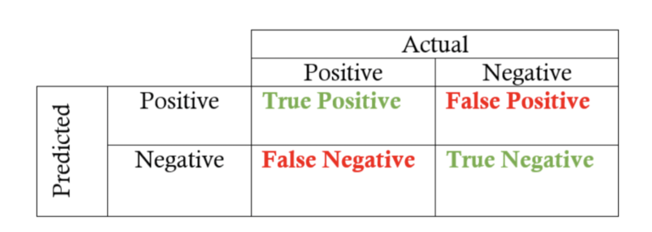
1.6.5 Limitations of Test Automation: False Positives and Negatives
Automated tests sometimes produce false positives or false negatives due to insufficient test coverage.
issue that doesn't exist
waste time and effort
False positive
False Negative
missing actual issues
fails to catch the real issue present in the application.
very serious and can create problems in production.
Notes:
Notes to the Facilitator:
Address the challenge of false positives and negatives in automated testing, emphasizing the impact of insufficient test coverage on potentially wasting time and effort investigating non-issues or missing critical problems in the application.
Notes to the Participants:
False Positives and Negatives:
Automated tests sometimes produce false positives or false negatives. It often happens due to insufficient test coverage.
A false positive happens when a test indicates the presence of an issue that is not present. False positives can waste a lot of tester and developer time and effort as the teams start to investigate an issue that is not present.
Similarly, a false negative happens when a test fails to catch the real issue present in the application. These issues are very serious because they are actual issues that can create problems in production.

Slide 33
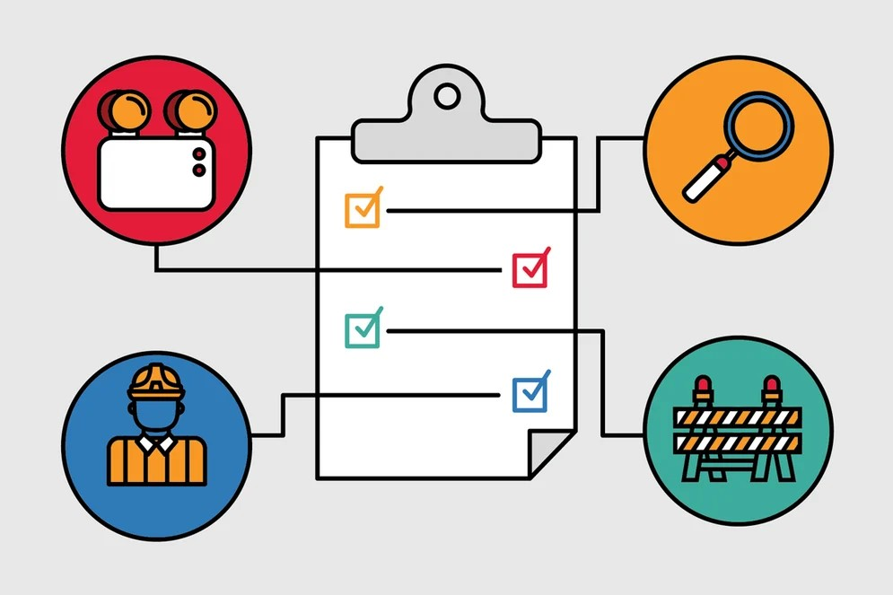
1.7.0 Mitigation Strategies
By understanding the mitigation strategies, one can address false positives and false negatives and improve the accuracy of the tests, making sure that the issues are caught and reported.
Some of the mitigation strategies are:
Review and debug scripts
Diversify test data
Improve test environment stability
Widen test coverage
Regular maintenance
Combine automated and manual Testing
Notes:
Notes to the Facilitator:
Emphasize the significance of mitigation strategies to address false positives and negatives, including script review, diverse test data, stable environments, broadened test coverage, regular maintenance, and a balanced approach with both automated and manual testing for improved test accuracy.
Notes to the Participants:
Mitigation Strategies:
By understanding the mitigation strategies, one can address false positives and false negatives and improve the accuracy of the tests, making sure that the issues are caught and reported. Some of the mitigation strategies are:
Review and debug scripts:
Always review and debug automated test scripts.
Identify and address potential issues that can create false positives or false negatives.
Diversify test data:
Make sure to use a diverse and real-world dataset to reduce the chances of false positives or negatives.
Improve test environment stability:
A stable and reliable test environment is critical to reducing false positives.
Widen Test Coverage:
Widen the test coverage to include a large set of scenarios for complete testing and reduce false negatives.
Regular Maintenance:
Regularly update, review, and maintain automated test scripts to incorporate changes in the application.
Combine automated and manual testing:
If 100% automation is not possible, then use a combination of automated and manual testing to mitigate the limitations.

Slide 34
What did you grasp?
How does using a diverse and real-world dataset contribute to the mitigation of false positives or negatives?
It increases the chances of false negatives
It decreases the chances of false negatives
It has no impact on false positives or negatives
It slows down the testing process
Notes:
Notes to the Facilitator:
Ask the participants to attempt the question on the screen.
Answer: B
Notes to the Participants:
Attempt the question on the screen.

Slide 35

1.8.0 Cases Suitable For Automation
The right decision to automate the right case leads to a successful test automation strategy. Some criteria that help determine which test cases to automate are:
Repetitive test cases
High-risk test cases
Data-driven test cases
Complex test cases
Stable test cases
Regression test cases
Performance and load test cases
Integration test cases
API test cases
Notes:
Notes to the Facilitator:
Emphasize the crucial role of selecting the right test cases for automation, considering factors like ROI and maintenance effort. Introduce different criteria such as repetitiveness, high risk, data-driven, etc. for an efficient and effective testing process.
Notes to the Participants:
Deciding on which test cases to automate is a critical part of a successful test automation strategy. We now know that 100% automation is not possible or practical; it is critical to select the right cases to improve the efficiency of the testing process. When selecting test cases for automation, we need to consider the return on investment (ROI) and the maintenance effort. Test cases that are well-suited for automation contribute to an efficient and effective testing process.
Some criteria that help determine which test cases to automate are:
Repetitive test cases:
Automate those test cases that need to be executed frequently, such as regression tests, smoke tests, and repetitive functional tests.
High-Risk Test Cases:
Automate those test cases that cover critical functionalities.
Data-Driven Test Cases:
Automate those test cases that involve multiple sets of input data to validate various scenarios.
Complex Test Cases:
Automate test cases that involve complex business logic or scenarios.
Automate test cases that are time-consuming and error-prone when performed manually.
Stable Test Cases:
Automate those test cases that are stable and unlikely to change frequently.
Regression Test Cases:
Automate test cases that are part of the regression to quickly identify any regressions introduced by recent code changes.
It helps in getting rapid feedback.
Performance and Load Test Cases:
Automate test cases for performance and load testing to address high volumes of concurrent users or stress scenarios.
Integration Test Cases:
Automate those test cases that verify the interactions between components.
It would help in identifying issues in the communication between different parts of the application software.
API Test Cases:
Automate test cases that validate the functionality and reliability of application programming interfaces (APIs).
It ensures the correct behavior of backend services.

Slide 36
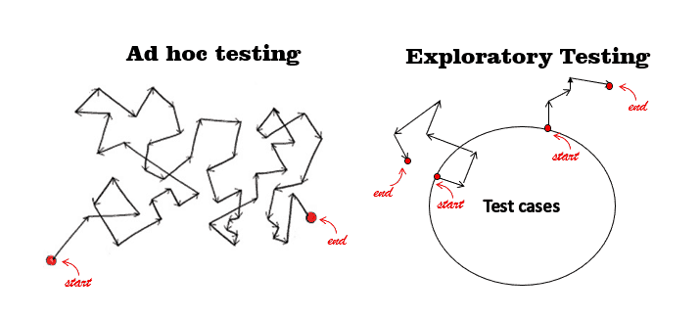
1.9.1 Cases Difficult For Automation
Certain cases are challenging to automate due to the nature of the tests, their complexity, and the limitations of the automation tools. Some of the cases are:
Exploratory testing:
exploration of the application to catch defects
dynamic and based on the tester's intuition.
Ad Hoc Testing:
unplanned testing activities performed without predefined test cases
spontaneous nature of ad hoc testing
Notes:
Notes to the Facilitator:
Acknowledge the complexities of automating dynamic tests like exploratory and ad hoc testing due to their nature and spontaneity. Emphasize the value of combining manual and automated methods for effective testing in such scenarios.
Notes to the Participants:
Certain test cases are challenging to automate. These challenges arise mainly due to the nature of the tests, their complexity, and the limitations of the automation tools. Despite the challenges, it is important to consider a combination of both manual and automated methods if possible.
Some of the scenarios that are difficult to automate are:
Exploratory testing:
Exploratory testing involves the exploration of the application to catch defects.
As the nature of this testing is dynamic and based on the tester's intuition, it is challenging to write a script to automate the test scenarios.
Ad Hoc Testing:
Ad hoc testing involves unplanned testing activities that are performed without predefined test cases.
The unstructured and spontaneous nature of ad hoc testing makes it difficult to create automated scripts.

Slide 37
1.9.2 Cases Difficult For Automation
There are more challenges in automating test cases involving:
Non-Deterministic Failures:
Exhibit intermittent failures due to environmental factors or network issue
Tracking, debugging and maintaining
Unstable Environments:
Severe challenges if environment is unstable
Application may behave inconsistently in unstable environment
Changes of producing false positives or false negatives results
Stochastic Behavior:
Random inputs may not be easy to automate
predicting and verifying specific outcomes becomes challenging
Notes:
Notes to the Facilitator:
Recognize the difficulties posed by non-deterministic failures, unstable environments, and stochastic behavior in automated testing, emphasizing the challenges of tracking, debugging, and maintaining tests under such conditions.
Notes to the Participants:
Non-Deterministic Failures:
Some test cases may exhibit intermittent failures due to environmental factors, network issues, or timing dependencies.
Tracking, debugging, and maintaining automated tests in such scenarios can be challenging.
Unstable Environments:
Automated tests may face severe challenges if the environment is unstable.
The application will behave inconsistently in an unstable environment.
There are high chances of producing false positives or false negative results.
Stochastic Behavior:
Test cases that involve random inputs may not be easy to automate.
It is because predicting and verifying specific outcomes becomes challenging.

Slide 38
1.9.3 Cases Difficult For Automation
There are more challenges in automating test cases involving:
Hardware Interaction:
Direct interaction with hardware devices could be difficult to automate
Automation tools designed to interact with software interfaces and not hardware interface
Cross-Cutting Concerns:
Test cases that involve cross-cutting concerns such as logging, security, or error handling across multiple components are complex to automate.
Notes:
Notes to the Facilitator:
Acknowledge the challenges in automating test cases involving direct hardware interaction and cross-cutting concerns, emphasizing the limitations of automation tools designed primarily for software interfaces.
Notes to the Participants:
Hardware Interaction:
Test cases that involve direct interaction with hardware devices could be difficult to automate.
Automation tools are often designed to interact with software interfaces and not hardware interfaces.
Cross-Cutting Concerns:
Test cases that involve cross-cutting concerns such as logging, security, or error handling across multiple components are complex to automate.

Slide 39
What did you grasp?
Which type of test cases in a test automation strategy is focused on verifying interactions between components to identify communication issues within the application?
Performance test cases
Integration test cases
Data-driven test cases
API test cases
Notes:
Notes to the Facilitator:
Ask the participants to attempt the question on the screen.
Answer: B
Notes to the Participants:
Attempt the question on the screen.

Slide 40
1.10.0 Automated Testing Process
The automated testing process generally follows the following series of steps:
Test Tool Selection
Maintenance
Define scope of Automation
Automated Testing Process
Test
Execution
Planning, Design and Development
Notes:
Notes to the Facilitator:
Introduce the generalized steps of the automated testing process to the participants.
Notes to the Participants:
The test automation process involves a series of steps and activities for creating, executing, and maintaining automated tests. The automated testing process generally follows the following series of steps:
Test Tool Selection
Define scope of Automation
Planning, Design and Development
Test Execution
Maintenance
Let's discuss each of the above in more detail.

Slide 41
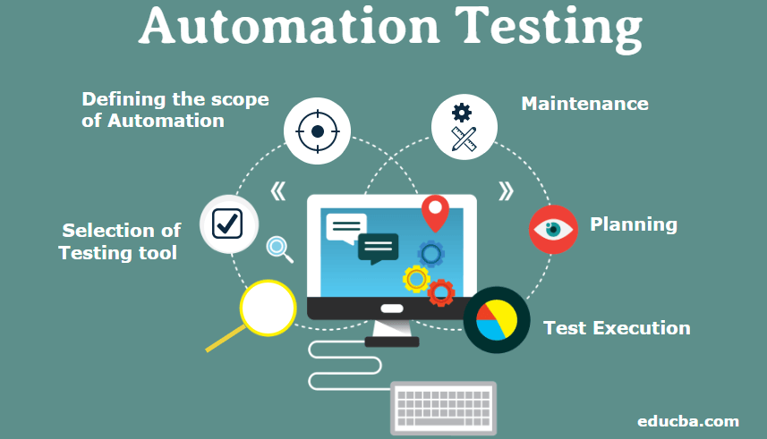
1.10.1 Step-1 Test Tool Selection
Selecting a right test automation tool has a significant impact on the success of our test strategy. The choice of tool depends on various factors such as:
Technology stack in which the application is developed
Type of testing required
Skill set of the testing team
Other project-specific requirements
Popular automation tools include Selenium, Appium, JUnit, TestNG, and others
Notes:
Notes to the Facilitator:
Highlight that choosing the right test automation tool is the initial crucial step, emphasizing its impact on test strategy success and considering factors like technology stack, testing type, team skills, and project requirements.
Notes to the Participants:
Deciding on a suitable test automation tool is often based on the technology stack on which the application is developed. Selecting the right test automation tool is important as it has a significant impact on the success of our test strategy. The choice of tool depends on various factors such as:
the technology stack in which the application is developed
the type of testing required
the skill set of the testing team
other project-specific requirements
Some of the popular automation tools include Selenium, Appium, JUnit, TestNG, and others.

Slide 42
1.10.2 Step-2 Define scope of Automation
The scope of automation is influenced by various factors such as:
Project requirements
Timelines
Resources
Nature of the application
Technical feasibility
Common functionality across application
Scope of the automation means how much of the software is automated.
Notes:
Notes to the Facilitator:
Highlight that defining the automation scope is a crucial second step in the process, setting boundaries and objectives influenced by factors like project requirements, timelines, resources, application nature, technical feasibility, and common functionality.
Notes to the Participants:
Define scope of Automation:
Scope of the automation means how much of the software is automated. Defining the scope sets the boundaries and objectives for the automation effort. The scope of automation is influenced by various factors such as:
Project requirements
Timelines
Resources
Nature of the application
Technical feasibility
Common functionality across application

Slide 43
1.10.3 Step-3 Planning, Design and Development
The following activities are carried out as part of this step:
Select automation tools based on the technology stack.
Define the test environment, resource allocation, and execution schedule.
Design an efficient and maintainable test automation architecture, including a script structure for test data.
Incorporate mechanisms for handling errors and exceptions during implementation.
Integrate, verify, and validate automation scripts within the chosen framework and integrate them into the CI/CD pipeline.
Three integrated activities are involved in this step: planning, designing, and implementation.
Notes:
Notes to the Facilitator:
Explain the critical activities involved in the third step of the automated testing process to the participants.
Notes to the Participants:
Three integrated activities are involved in this step: planning, designing, and implementation. Overall, the following activities are carried out as part of this step:
Automation tools are selected based on the technology stack.
Define the test environment and allocate resources such as skilled engineers, environments, and necessary hardware and software.
Define the frequency and schedule for test execution.
Design an effective and maintainable test automation architecture.
Define a test script structure with provisions for test data handling.
Incorporate mechanisms for handling errors and exceptions.
Implement and integrate scripts into the chosen automation framework.
Verify and validate the correctness of automation scripts.
Integrate automated tests into the continuous integration/continuous deployment pipeline.

Slide 44
1.10.4 Step-4 Test Execution
The following activities are carried out as part of this step:
Trigger the execution of automated test scripts – CICD or scheduled
Manage configurations and dependencies for a consistent environment.
Collect test results, including status, execution time, and logs.
Generate comprehensive test reports summarizing the results of the test execution.
Based on the feedback, update automated test scripts, data, and configurations.
It is the process of executing the automation scripts designed and developed in the previous steps to test the defined functionality of the software.
Notes:
Notes to the Facilitator:
Explain to the participants that in the fourth step of automated testing—test execution—they'll initiate scripts, manage configurations, collect results, generate reports, and refine scripts based on feedback.
Notes to the Participants:
Test Execution:
It is the process of executing the automation scripts designed and developed in the previous steps to test the defined functionality of the software. The following activities are carried out as part of this step:
Trigger the execution of automated test scripts. It could be done automatically as part of a continuous integration or continuous deployment pipeline, or it could be scheduled for execution at a specific time.
Manage configurations and dependencies to ensure that the test environment is consistent.
Collect test results, including status, execution time, and logs generated during the test run.
Generate comprehensive test reports summarizing the results of the test execution.
Based on the feedback, update automated test scripts, data, and configurations.

Slide 45
1.10.5 Step-5 Maintenance
The major key activities performed in this step are:
Refactor automation scripts for improvement.
Review and update test data.
Improve error handling.
Integrate new test cases to expand the coverage as functionality expands.
Document test scripts and any associated artifacts up to date
Conduct retrospectives and gather feedback from the team.
It involves activities related to the ongoing management, enhancement, and optimization of automated test scripts.
Notes:
Notes to the Facilitator:
Explain to the participants that in the maintenance step, they'll refine scripts, update data, enhance error handling, integrate new cases, and keep the documentation current for sustained efficiency.
Notes to the Participants:
Maintenance
Test Automation maintenance step in test automation involves activities related to the ongoing management, enhancement, and optimization of automated test scripts. This step ensures that the automated tests remain effective efficient and aligned with the requirements of the software application being tested. This step is executed when new automation scripts are added and need to be reviewed and maintained.
The major key activities performed in this step are:
Refactor automation scripts for improvement.
Review and update test data to ensure that it remains relevant.
Improve error handling mechanisms to capture additional details and provide more informative error messages.
Integrate new test cases into the existing automation suite to expand the coverage as functionality expands.
Document test scripts, including frameworks and any associated artifacts up to date
Conduct retrospectives to reflect on the automation process and gather feedback from the team.

Slide 46
1.11.1 Best Practices of Automating Testing
Automated testing is a very beneficial and powerful approach to software testing if we follow the best practices. To achieve the best results, one needs to follow the best practices as follows:
Clear Objectives Definition:
Clearly define the objectives of automated testing
Understand the purpose
Select Appropriate Test Cases:
Select test cases that are suitable for automation
Give priority to repetitive and time consuming test scenarios
Avoid scenarios such as exploratory testing that are best suited for manual testing
Notes:
Notes to the Facilitator:
Explain the best practices of automated testing to the participants.
Notes to the Participants:
Automated testing is a very beneficial and powerful approach to software testing if we follow the best practices. To achieve the best results, one needs to follow the best practices as follows:
Clear Objectives Definition:
Always clearly define the objectives of automated testing.
Understanding the purpose always supports creating a suitable automation strategy.
Select appropriate test cases:
Select test cases that are suitable for automation.
Give priority to repetitive and time-consuming test scenarios.
Avoid scenarios such as exploratory testing that are best suited for manual testing.

Slide 47
1.11.2 Best Practices of Automating Testing
To achieve the best results, one needs to follow the best practices as follows:
Right Test Automation Tool:
Choose a right test automation tool
Look for factors such as ease of use and community support
Scalable Framework:
Design a modular, scalable, and maintainable automation framework.
Use proper structure for reusability.
Notes:
Notes to the Facilitator:
Explain the best practices of automated testing to the participants.
Notes to the Participants:
Right Test Automation Tool:
Choose the right test automation tool that matches the technology of the application.
Look for factors such as ease of use and community support.
Scalable Framework:
Design a modular, scalable, and maintainable automation framework.
Use proper structure that leads to reusability and enables the easy addition of new test cases.

Slide 48
1.11.3 Best Practices of Automating Testing
To achieve the best results, one needs to follow the best practices as follows:
Coding Standards:
Stick to coding standards and best practices.
Document code; write clean and readable code.
Use meaningful variable and method names.
Use Version Control:
Use version control for automation scripts and code.
Ensures traceability, collaboration, and easy rollback in case of issues.
Notes:
Notes to the Facilitator:
Explain the best practices of automated testing to the participants.
Notes to the Participants:
Coding Standards:
Stick to coding standards and best practices when writing automation scripts.
Document code, Write clean and readable code; use meaningful variable and method names.
Add comments and indentation to the code.
Use Version Control:
Use version control for automation scripts and code.
Ensures traceability, collaboration, and easy rollback in case of issues.

Slide 49

1.12.1 Automation Testing Tools: Selenium
It is a powerful open-source test automation tool widely used for automating web browsers.
Some of the key features are:
Supports the automation of actions performed in web browsers.
Support for multiple programming languages such as Java, Python, C#, and others
Allow developers to write test cases using their choice of language.
Supports the execution of tests in parallel across multiple machines.
Easily integrated with testing frameworks like TestNG and Junit
Easily integrated into CI/CD pipelines
Large, active community base for documentation and other resources
Notes:
Notes to the Facilitator:
Introduce Selenium as a robust open-source tool for web browser automation, highlighting its support for various programming languages, parallel test execution, seamless integration, and the advantage of a vibrant community for support and resources.
Notes to the Participants:
Selenium :
It is a powerful open-source test automation tool widely used for automating web browsers. It supports multiple programming languages, such as Java, Python, and C#, and provides a suite of tools and libraries for web application testing. It supports playback and recording facilities.
Some of the key features are:
It supports the automation of actions performed in web browsers, such as clicking buttons, filling out forms, and other activities.
It supports multiple programming languages, such as Java, Python, C#, and others, allowing developers to write test cases using their choice of language.
It supports the execution of tests in parallel across multiple machines.
It can be easily integrated with testing frameworks like TestNG and Junit.
It can be easily integrated into continuous integration and continuous deployment (CI/CD) pipelines.
Since it is open-source, it has a large, active community where we can find documentation and other resources to support the development.

Slide 50

1.12.2 Automation Testing Tools: Appium
It is an open-source, cross-platform test automation tool for native, hybrid, mobile web, and desktop apps.
Why Appium?
Use of standard automation APIs on all platforms.
Use any development tools using any WebDriver-compatible
Various third-party client implementations exist for other languages.
Use any testing framework.
Run automated tests locally and in the cloud.
Several major cloud providers offer support for a wide range of Appium drivers.
Visual debugging of automated tests
Notes:
Notes to the Facilitator:
Introduce Appium as a versatile open-source tool for cross-platform test automation, emphasizing its compatibility with standard APIs, support for multiple languages, and visual debugging features, making it user-friendly for testers of all levels
Notes to the Participants:
Appium is an open-source, cross-platform test automation tool for native, hybrid, mobile web, and desktop apps. Initially created to automate iOS and Android mobile applications, Appium has grown into a full-featured platform that provides WebDriver-based automation possibilities for a whole set of different mobile and desktop platforms.
Why Appium?
You usually don't have to recompile or modify your app in any way, due to the use of standard automation APIs on all platforms.
You can write tests with your favorite dev tools using any WebDriver-compatible language, such as Java, JavaScript, Python, Ruby, or C#, with the Selenium WebDriver API. There are also various third-party client implementations for other languages.
You can use any testing framework.
You can run your automated tests locally and in the cloud. Multiple cloud providers support various Appium drivers (mostly targeting iOS and Android mobile automation).
Appium Inspector allows visual debugging of automated tests and could be extremely useful for beginners.

Slide 51

1.12.3 Automation Testing Tools: TestNG
This testing framework is inspired by JUnit and NUnit but introduces new functionalities that enhance its power and usability.
Key features of TestNG:
Run your tests in arbitrarily big thread pools with various policies.
The test code is multithread-safe.
Flexible test configuration
Support for data-driven testing (with @DataProvider).
Support for parameters.
Powerful execution model (no more TestSuite).
Supported by a variety of tools and plug-ins (Eclipse, IDEA, etc.).
TestNG is designed to cover all categories of tests: unit, functional, end-to-end, integration, etc.
Notes:
Notes to the Facilitator:
Introduce TestNG, a powerful testing framework with features like annotations, flexible configuration, data-driven testing, and support for various test types, aiming to enhance testing efficiency and versatility.
Notes to the Participants:
TestNG:
TestNG is a testing framework that draws inspiration from JUnit and NUnit while introducing new functionalities that enhance its power and ease of use.
Key features of TestNG are as follows:
Annotations.
Run your tests in arbitrarily big thread pools with various policies available (all methods in their thread, one thread per test class, etc.).
Test that your code is multithread-safe.
Flexible test configuration.
Support for data-driven testing (with @DataProvider).
Support for parameters.
Powerful execution model (no more TestSuite).
Supported by a variety of tools and plug-ins (Eclipse, IDEA, Maven, etc.).
Embeds BeanShell for further flexibility.
Default JDK functions for runtime and logging (no dependencies).
Dependent methods for application server testing.
TestNG is designed to cover all categories of tests: unit, functional, end-to-end, integration, etc.

Slide 52
In a nutshell
In this module, you have learned:
About test automation
Various types of testing
Why one should go for test automation
Differences between automation and manual testing
Scenarios suitable and unsuitable for test automation
Criteria for test automation tool selection
Best practices for automated testing
Benefits and limitations of automated testing
Test automation process
Test automation tools
Notes:
Notes to the Facilitator:
Share the module summary with the audience.
Ask the participants if they have any questions. They can ask their queries by raising their hands.
Notes to the Participants:
In this module, you have learned:
About test automation
Various types of testing
Why one should go for test automation
Differences between automation and manual testing
Scenarios suitable and unsuitable for test automation
Criteria for test automation tool selection
Best practices for automating testing
Benefits and limitations of automated testing
Test automation process
Test automation tools

Slide 53
Module 2:

